Slide 1
Zombie Killer
Jialin Gao, Yiren Ding, Tianhao Fang, Shubhi Mittal

Slide 2
ZK-Team
Jialin Gao: project manager
Yiren Ding: development engineer
Tianhao Fang: development engineer
Shubhi Mittal: development engineer
Title of Project: Zombie Killer

Slide 3
Tools
Java
Eclipse/IntelliJ Idea
Github
Google Drive

Slide 4
Overview of Project
Demo Video

Slide 5
Basic Rule
Played in a zone 16000 units wide by 9000 units high
Human are present in the game zone, but will not move
Game ends by killing all zombies or all human are killed

Slide 6
Agent (Ash) Rule
The only agent Ash works as follows:
Ash can be told to move to any point within the game zone by outputting a coordinate X Y. The top-left point is 0 0.
Each turn, Ash will move exactly 1000 units towards the target coordinate, or onto the target coordinates if he is less than 1000 units away.
If at the end of a turn, a zombie is within 2000 units of Ash, he will shoot that zombie and destroy it. More details on combat further down
Ash could only see the surroundings (zombies, other people) within 3000 units

Slide 7
Zombies Rule
Zombies work as follows:
Each turn, every zombie will target the closest human, including Ash, and step 400 units towards them. If the zombie is less than 400 units away, the human is killed and the zombie moves onto their coordinate.
Two zombies may occupy the same coordinate.

Slide 8
Move Sequence
Zombie Move
Ash Move
Ash Kill Zombie
Zombie Kill Human

Slide 9
Project Plan
Project Plan and Project Management

Slide 10
Limitation of Online Compiler
Cannot run test repeatedly.
Do not support compile code in separate files.
Difficult to debug.

Slide 11
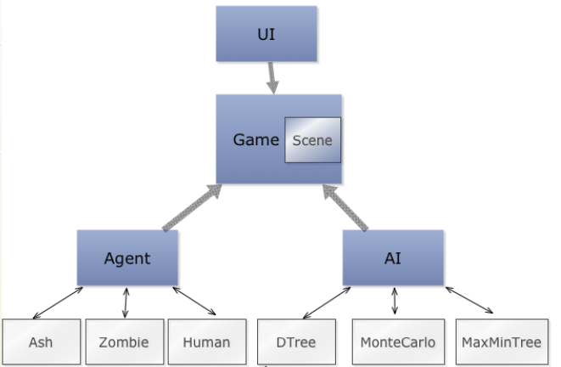
Architecture of game replica

Slide 12
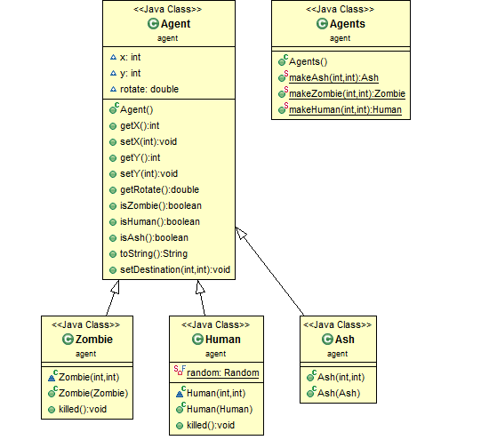
Agent
Three types of agent:
Ash
Human
Zombie
Using static factory design pattern to create new objects

Slide 13
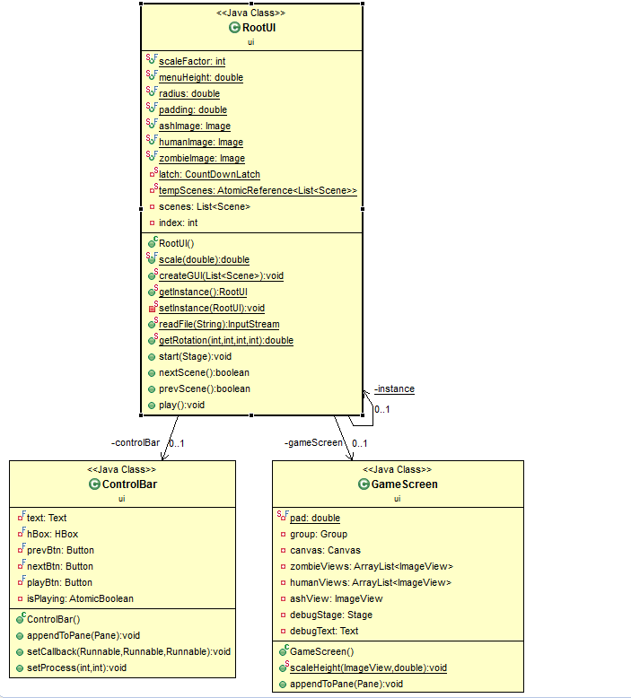
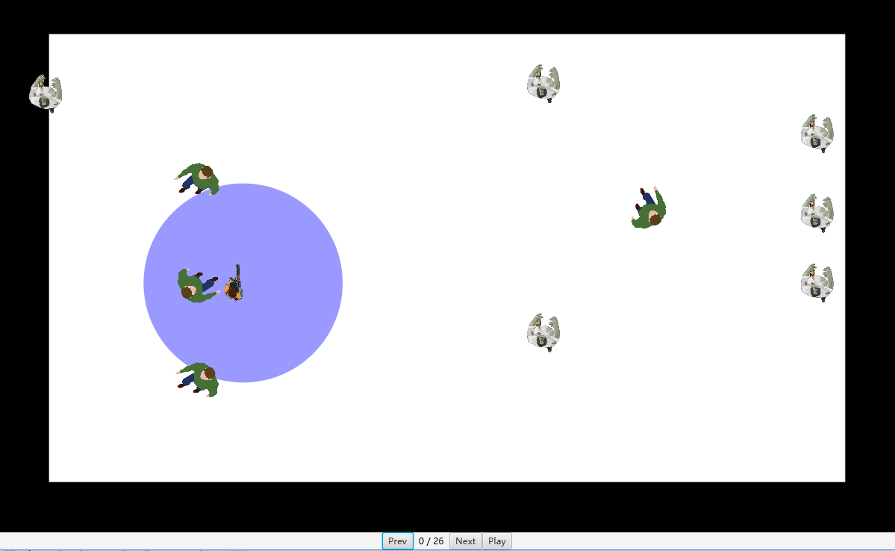
User Interface

Slide 14
Decision Tree
Decision tree is a flowchart-like structure.
Each internal node represents a test
Each branch represents the outcome of the test
Each leaf node represents an action

Slide 15
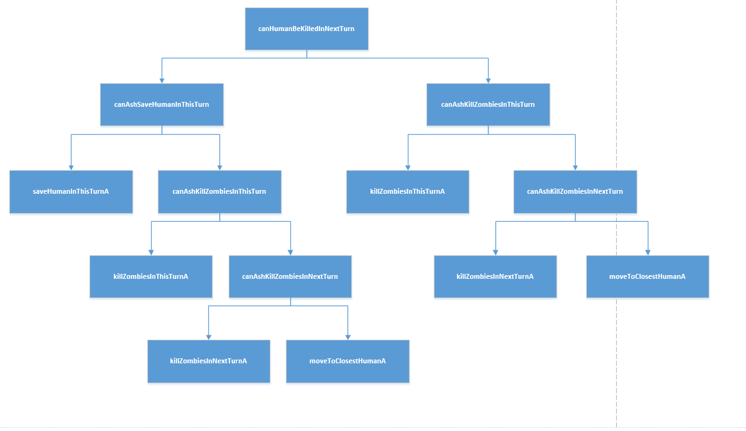
Decision Tree Diagrams

Slide 16
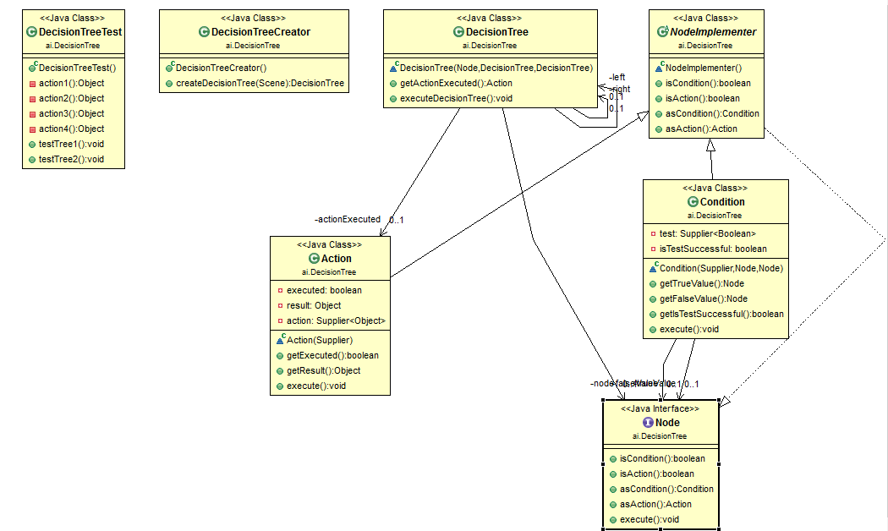

Slide 17
Monte Carlo
Monte Carlo methods (or Monte Carlo experiments) are a broad class of computational algorithms that rely on repeated random sampling to obtain numerical results.
Monte Carlo methods cannot guarantee finding optimal solution. But, with the increasement of sample size, the result will be close to optimal solution

Slide 18
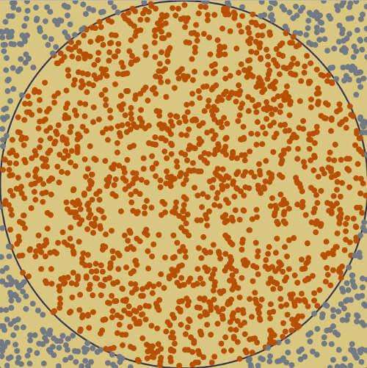
Monte Carlo-Simple Example
One simple example of Monte Carlo method is calculate π
Randomly put dot in the given area
AreaOfCircle/AreaOfSquare = π/4
The π will be the number of dot in circle/number of total dot

Slide 19
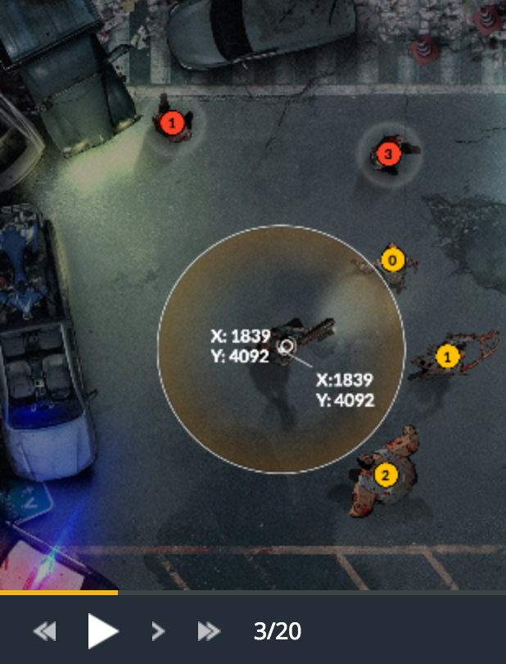
Monte Carlo-In Zombie Game
Randomly put dot in game setting.
Simulate game for each dot as Ash`s target.
Select the move that will give you highest score next scene.

Slide 20
Monte Carlo-In Zombie Game
Problem: the setting is very large, many random dot will give us same score.
Solution: place dot in a relatively small range

Slide 21
Monte Carlo Search Tree
Use limited depth, breadth-first search method to explore solutions. Generate the whole search tree first.
When it reaches depth limit or the game status reach pass or fail, stop expanding.
Collect all leaf node, and select the node with max value(greedy).
If several leaf have same score, pick the one with smaller depth.
Return the next to root node and retrieve move.

Slide 22
Performance Issue
Time Complexity: O(M^N)
Space Complexity: O(M^N)
M: sample size , N: search depth
A Typical Example: M=200, N=5. => 3.2*10^11

Slide 23
Solutions
Reduce sample size and search depth.
Reduce sample size by a certain rate for each search depth
Use Dynamic Programming, reduce computation space.

Slide 24
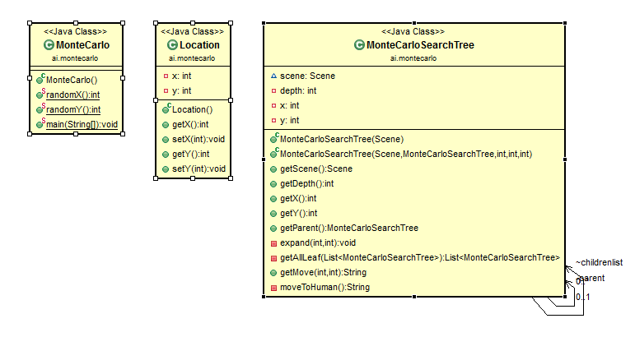

Slide 25
Maxmin
Maxmin algorithm is the algorithm that is widely used on turn-based games like cheese. The algorithm is used to make prediction of the future action of both players and opponents based on the assumption that both player and opponents will take their best possible action in each turn.
The search depth of maxmin algorithm is limited due to the fact the complexity of algorithm is O(a^n), where n is the search depth and a is the total amount of possible movement. However, maxmin algorithm will give precise best possible series of actions within the search depth, as long as the heuristic function correct.

Slide 26
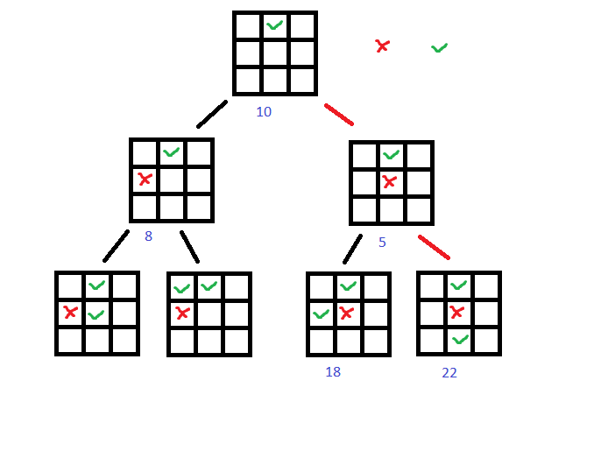
Demo of Maxmin
Start from a state of game
List the possible movement of player, every movement generate a new game state
Opponent do the same until to the limit of length

Slide 27
Demo of Maxmin
For player only choose the possible that maximum the heuristic function
For opponent only choose the possible movement that minimum the heuristic
Heuristic function is used to evaluate the status of game state for player to win

Slide 28
Maxmin
For the zombie game, the state is made of place of ash, place of zombies, place of human.
Action for this game is the movement
Every movement of zombie is fixed, that means the zombie movement is limited to one possible movement, the min process is limited.
The possible action for player is all the points within the range of ash speed, however, we only choose several special points in the range to reduce the number of branches.

Slide 29
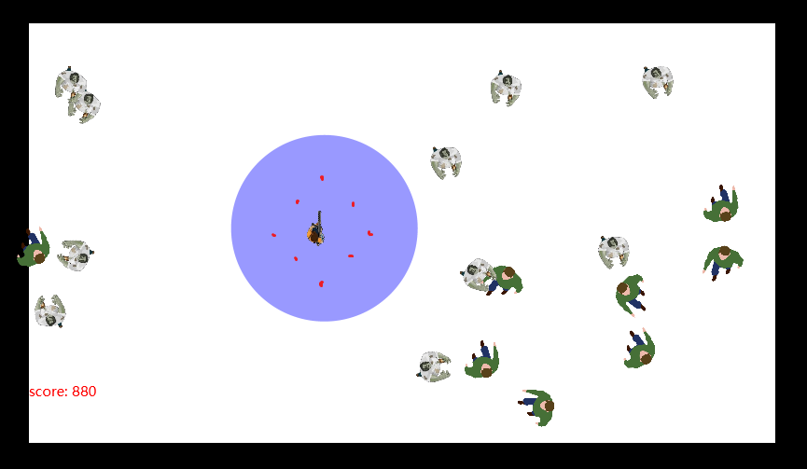
Maxmin

Slide 30
Maxmin
Heuristic function:
The function is considering following
Distance to nearest human
Score
Amount of remain human
Amount of human is valued most, score is valued second. The distance to nearest human will guide ash to nearest human if there is not zombie nearby
The maximum depth of search is 5, higher depth will predict more steps but take far more time.

Slide 31
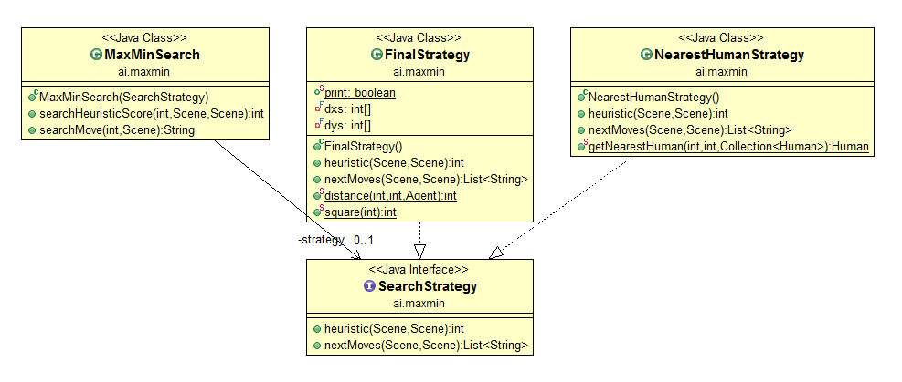

Slide 32
Result Comparison
16 Test Cases
Simplest Strategy （walk to closest alive human directly)
All test cases pass
Total: 4360
Time Consuming: 0.216s
Decision Tree:
All test cases pass
Total: 6430
Time Consume: 0.156s

Slide 33
Monte Carlo:
All test cases pass (not guarantee)
Total: 13980-16660
Time Consuming: 68.170s
Maxmin:
All test cases pass (depth = 3)
Total: 17100
Time Consuming: 2.587s
One test case fails (depth = 5)
Total: 25310
Time Consuming: 123.282s

Slide 34
Demo for Three Strategies
https://www.youtube.com/watch?v=VZf2zwl9ai8&feature=youtu.be

Slide 35
Codes
https://github.com/zombieProject/zombieGame

Slide 36
What we learned?
Improve skills of Java programming and fixing bugs
Consolidate the decision tree concept
Two new algorithms: Maximin and Monte Carlo
Have to concern performance issue

Slide 37
Future Work
A hybrid strategy with decision tree and Monte Carlo algorithm
The more advanced strategy with qualified performance

Slide 38
Reference
Coulom R. (2007) Efficient Selectivity and Backup Operators in Monte-Carlo Tree Search. In: van den Herik H.J., Ciancarini P., Donkers H.H.L.M.. (eds) Computers and Games. CG 2006. Lecture Notes in Computer Science, vol 4630. Springer, Berlin, Heidelberg.
Kocsis L., Szepesvári C. (2006) Bandit Based Monte-Carlo Planning. In: Fürnkranz J., Scheffer T., Spiliopoulou M. (eds) Machine Learning: ECML 2006. ECML 2006. Lecture Notes in Computer Science, vol 4212. Springer, Berlin, Heidelberg
Guillaume C,, Sander B, Istvan S and Pieter S. Monte-Carlo Tree Search: A New Framework for Game AI(2008) Proceedings of the Fourth Artificial Intelligence and Interactive Digital Entertainment Conference
Ronald L. Rivest.(1987) Game tree searching by min/max approximation Artificial Intelligence. Volume 34, Issue 1, December 1987, Pages 77-96

Slide 39
THANK YOU

